Slide 1
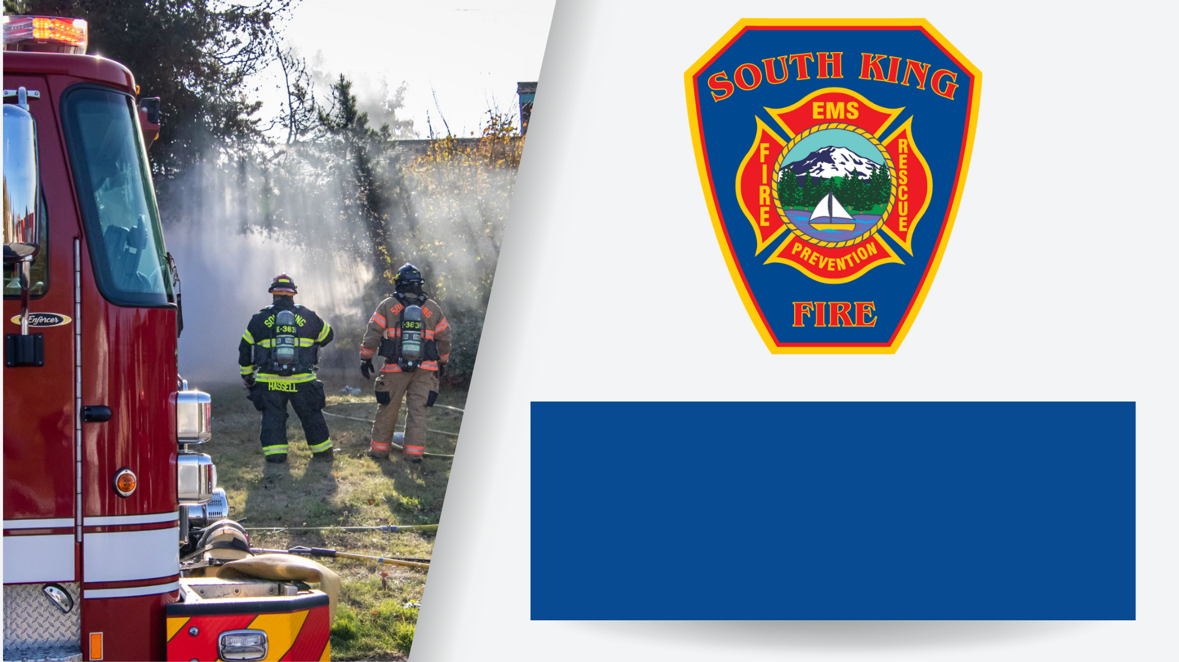
A Better Plan for the Future:
The Fire Benefit Charge (FBC)
Matching Rising Demand
with Stabilized Funding
Spring/Summer 2024 Presentation
Notes:
Intro for Community Presentations:
Hello and welcome, everyone! I am [NAME], and I serve as [POSITION] for South King Fire. I’ve been with South King Fire for [#] years, and in my role I [BRIEF JOB DESCRIPTION].
Staff & Community Presentations:
Today I am going to share South King Fire’s Better Plan for the Future, which is how we plan to address rising demands with the Fire Benefit Charge, also known as the FBC, which will be placed on the ballot later this summer on August 6, 2024.
My goal today is to provide some context and background, explain what the FBC entails and how it can positively impact South King Fire and the community by matching rising demand with stabilized funding.

Slide 2
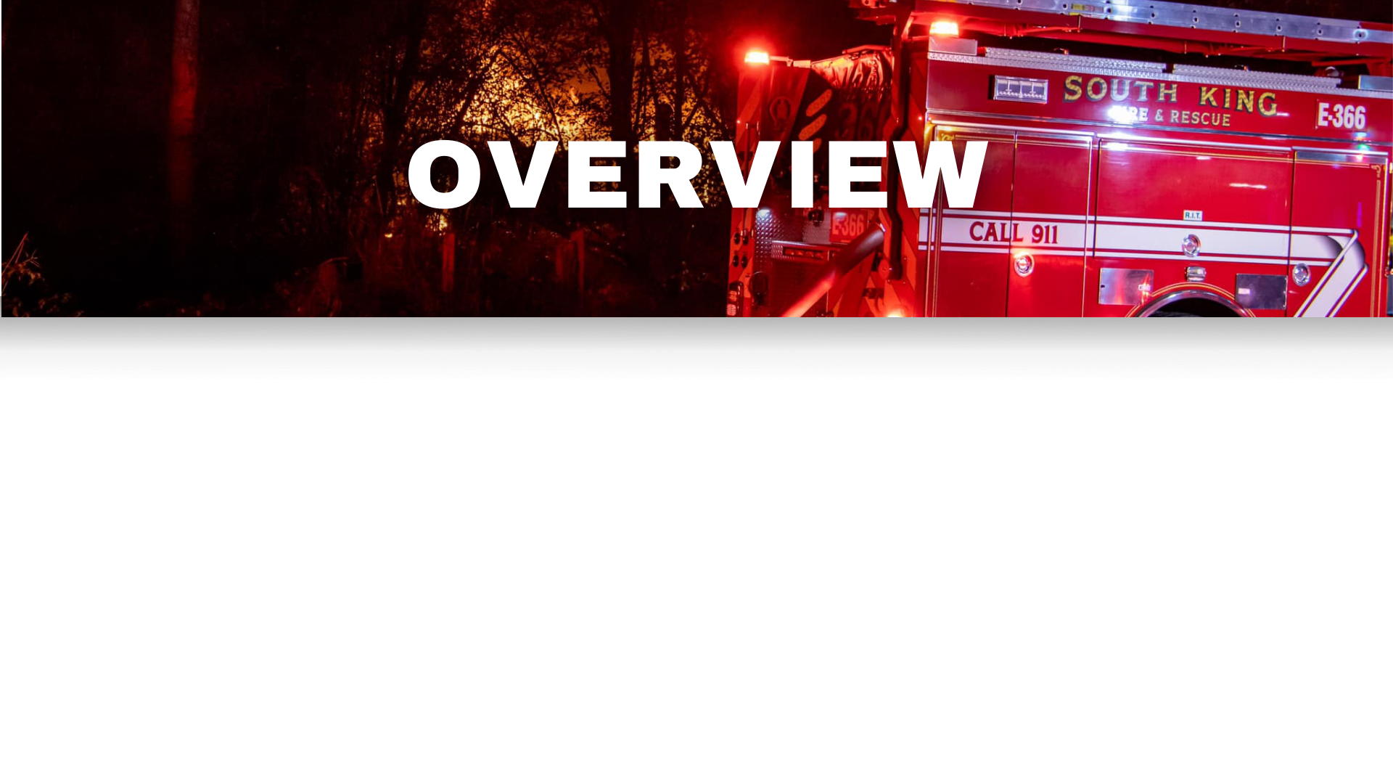
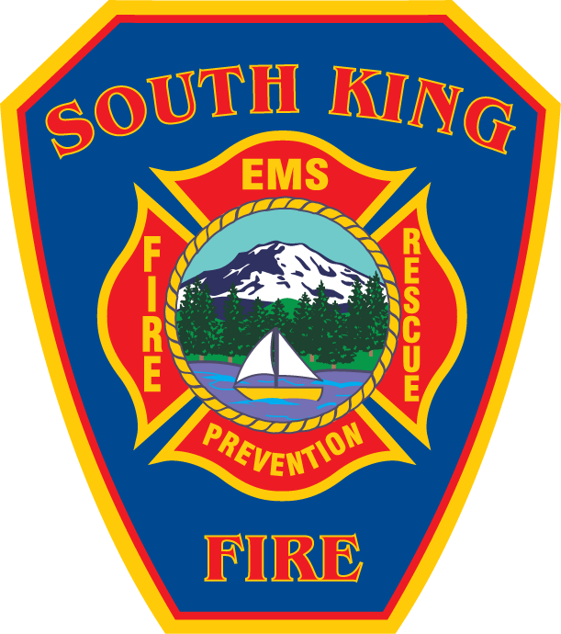

Who We Are, What We Do
Current and Future Demands
A Better Plan for the Future – The Fire Benefit Charge (FBC)
Funding Structure and Proposed FBC
Where to Find More Information
Notes:
During this presentation, I will talk about who we are and what we do, go into more detail about our emergency call stats, share our current funding model and the proposed FBC, and where to find more information.

Slide 3
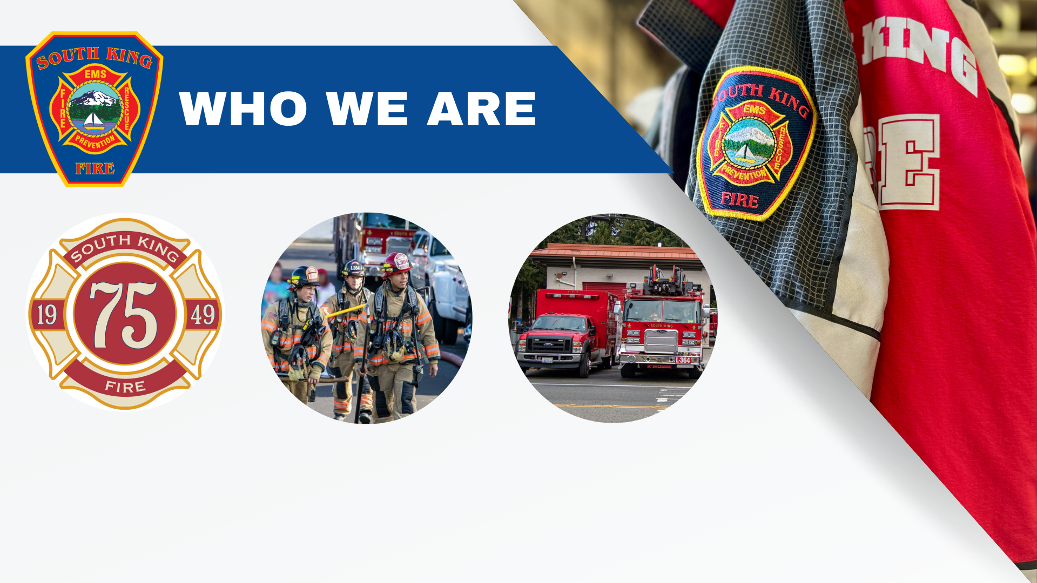
75 Years Strong
150+ Firefighters
7 Fire Stations
Notes:
This year marks our 75th anniversary of serving our communities 75 years. With seven fire stations and more than 150 firefighters, we are proud to serve our communities in times of fire and emergencies.

Slide 4
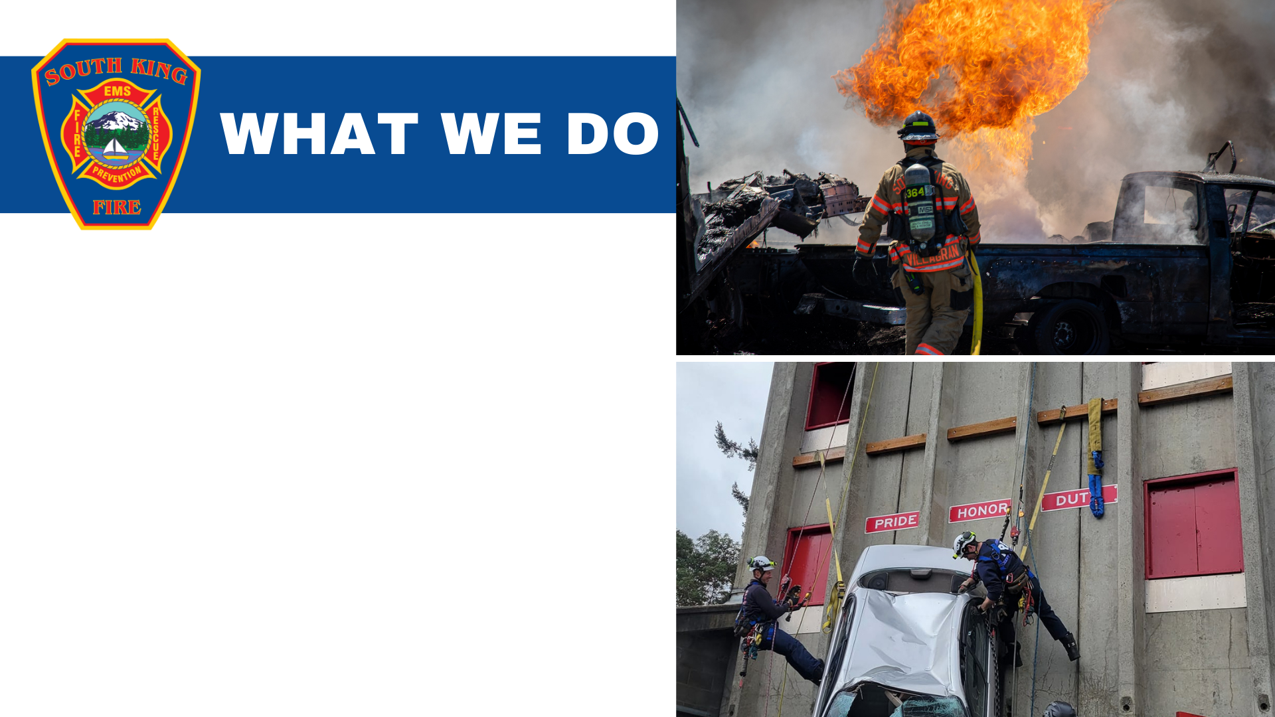
Emergency Medical Services (EMS)​
Fire Suppression​
Hazardous Materials (HazMat) Response, Maritime Emergencies, Water Rescue, Rescue Swimmers
Technical Rescues
Fire Inspections​
Permits​
Fire Plan Reviews​
Community Outreach & Engagement​
Notes:
Each day, our firefighters are on the front lines responding to emergencies and fires in our communities. They handle an increasing number of calls, ranging from motor vehicle collisions, medical emergencies, building fires, and other emergencies. Emergency calls make up a large majority of our responses.
We provide many other services to our community, as you can see here such as Hazardous Materials Response, Water Rescue, Fire Plan Reviews, and more.
[Feel free to elaborate (briefly) or provide examples or explanations about a few of these services.]

Slide 5
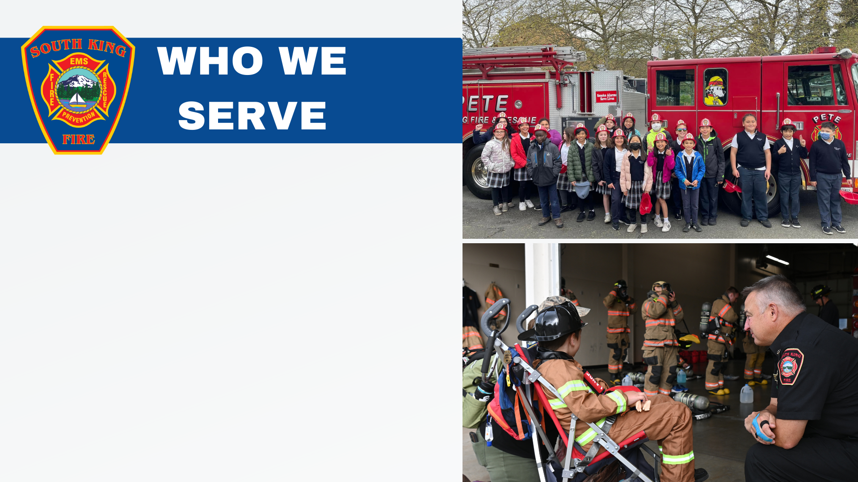
South King Fire serves a growing population of 160,000+ citizens
We cover 41 square miles including the communities of Des Moines, Federal Way, and unincorporated King County and 12 miles of Puget Sound coastline
Continued population growth in our district is expected to rise well into the future
Notes:
With a growing population of more than 160,000 citizens, we cover 41 square miles, including the communities of Des Moines, Federal Way, and unincorporated King County and 12 miles of Puget Sound coastline.
Population growth in our district is expected to rise well into the future.

Slide 6
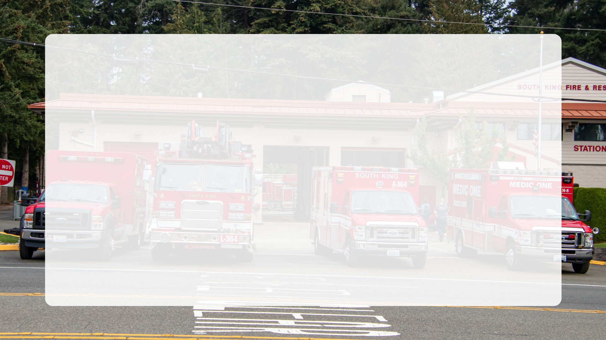
A Better Plan for the Future:
The FBC
Matching Rising Demand
with Stabilized Funding
Notes:
In order to uphold fiscal responsibility and effectively meet the rising demand, South King Fire is proposing a Fire Benefit Charge, or “FBC”. The FBC will provide more stable funding to better meet the current and future demands. This will improve resource availability, resulting in better response times.

Slide 7

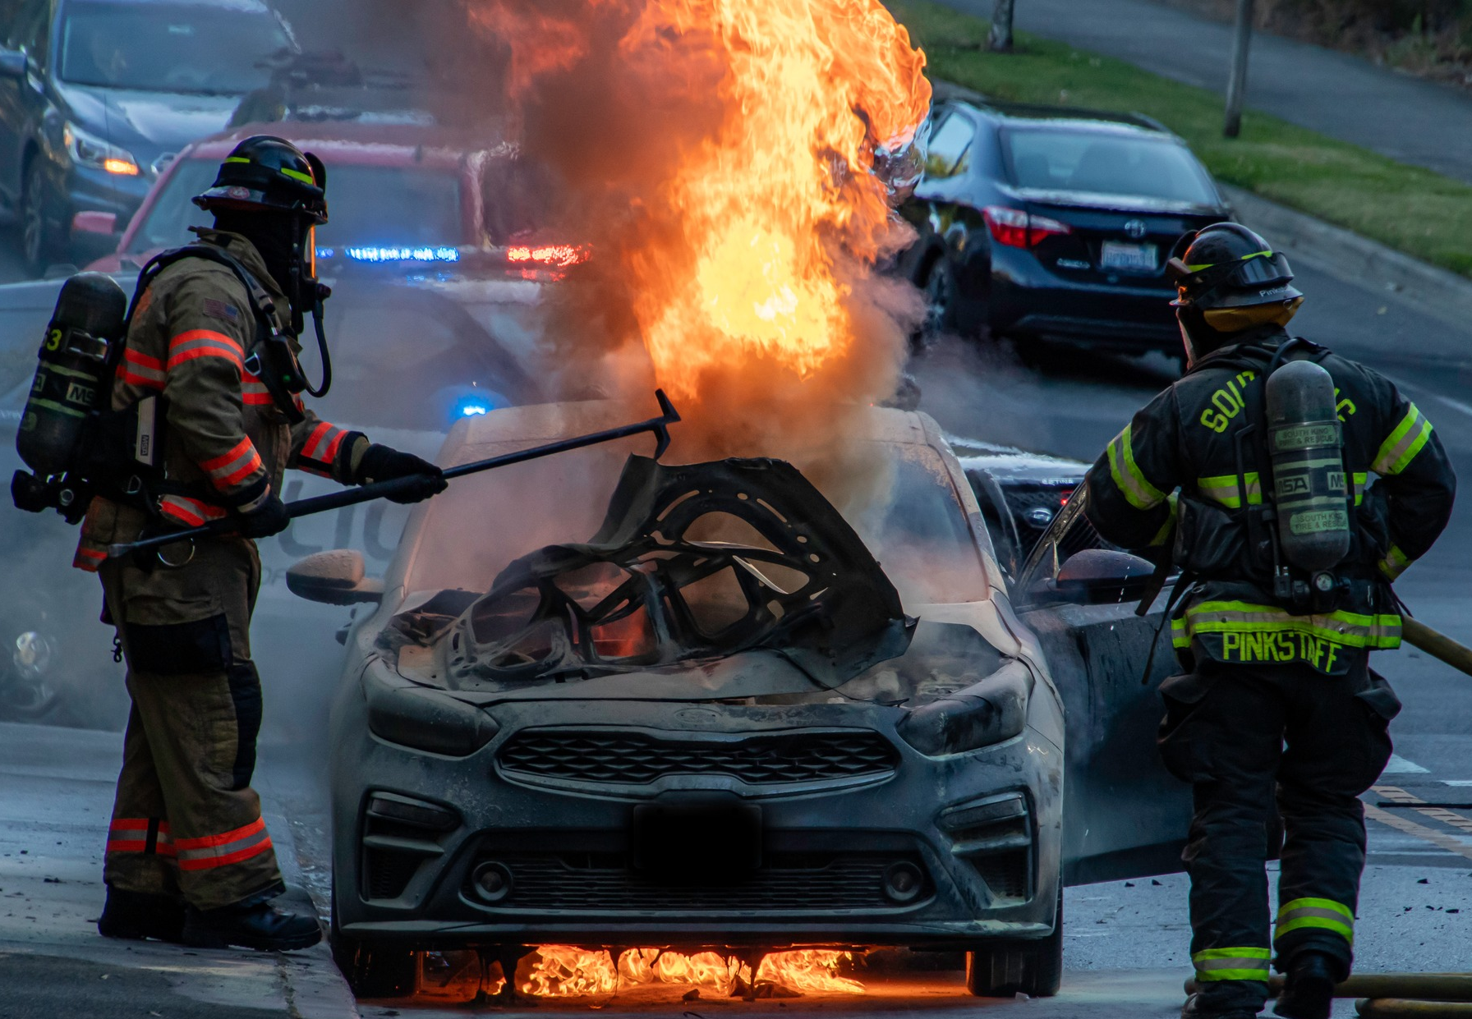
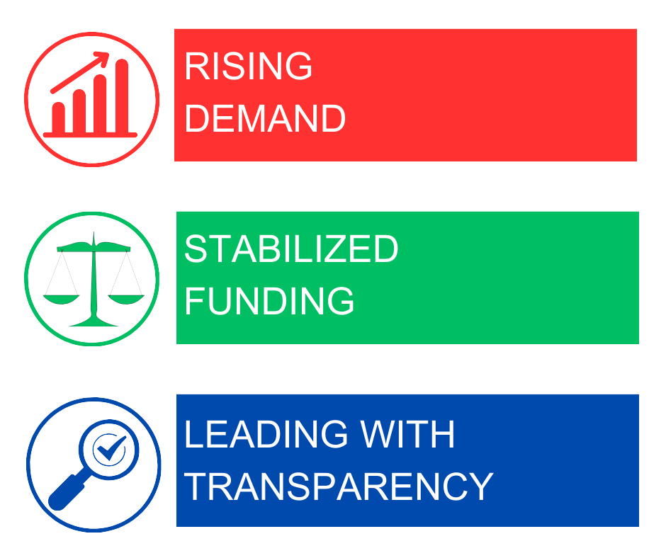
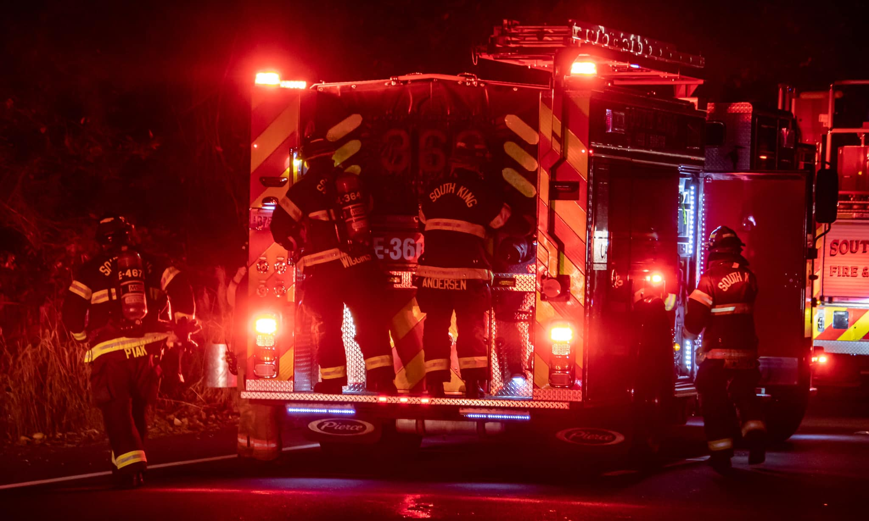
A Better Plan for the Future: The FBC
Matching Rising Demand with Stabilized Funding
Notes:
What we will cover today is the rising demand for emergency services, a stabilized funding model to address this growing need, and how we are being fiscally responsible and transparent about our needs to better serve the community.

Slide 8
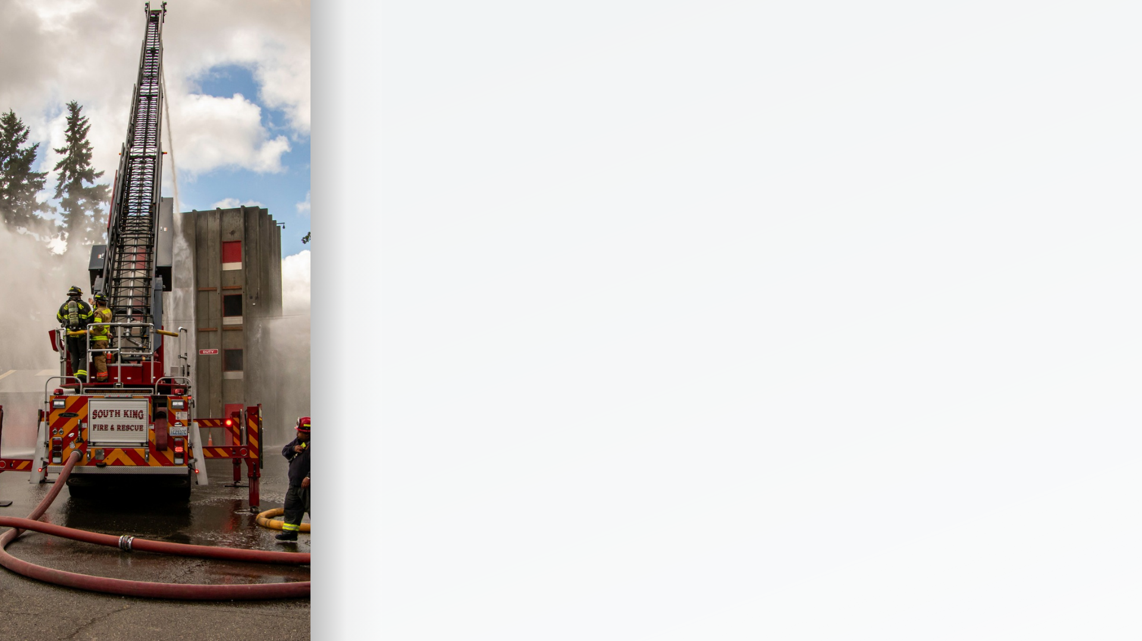
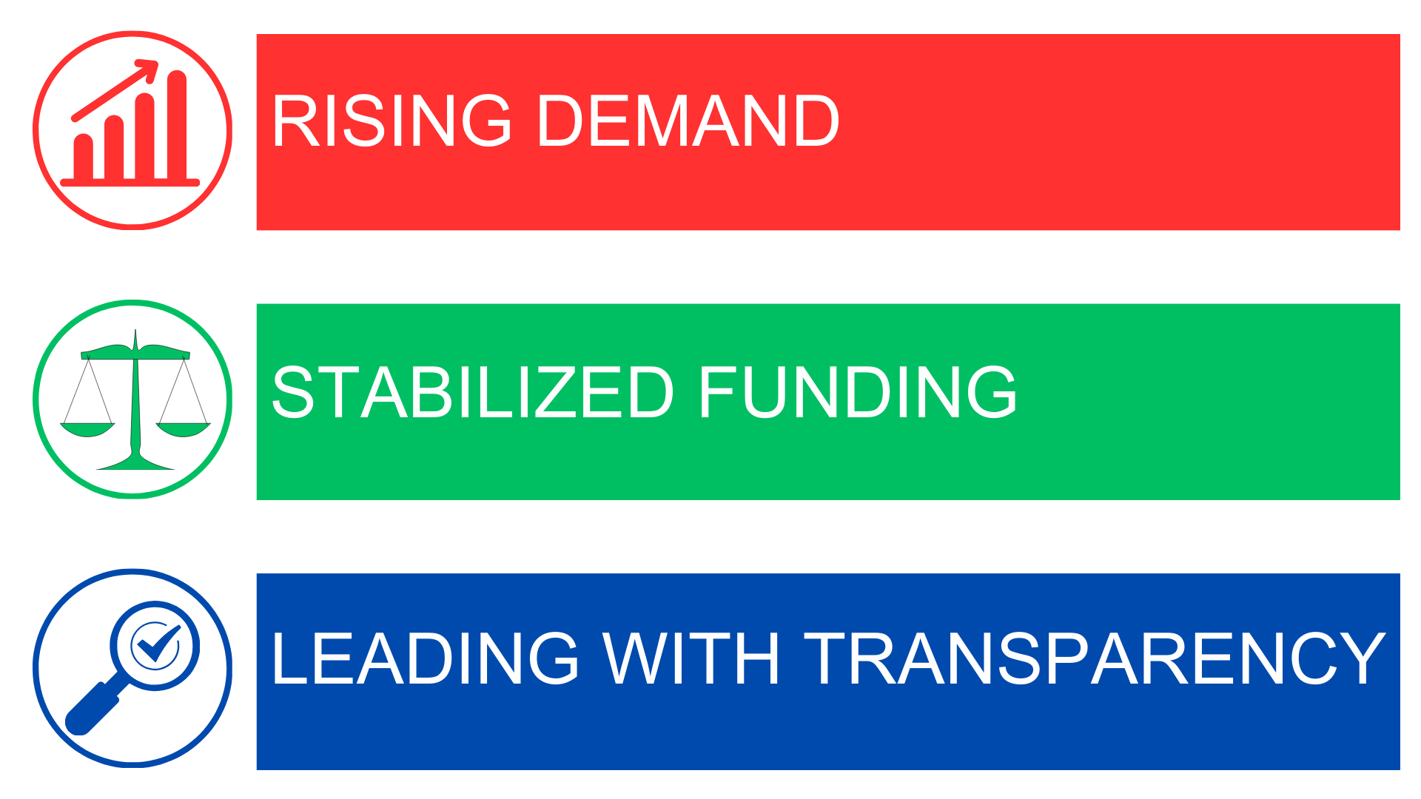

In 2012, South King Fire responded to 16,279 emergency 911 calls.
Fast forward to 2023, emergency 911 calls now exceed 25,000 annually, signifying a 54% increase compared to a decade ago.
54%
A Better Plan for the Future: The FBC
Matching Rising Demand with Stabilized Funding
Notes:
In 2012, South King Fire responded to 16,279 emergency 911 calls.
From 2012 to 2023, we’ve seen a 54% increase in 911 emergency calls compared to a decade ago.

Slide 9
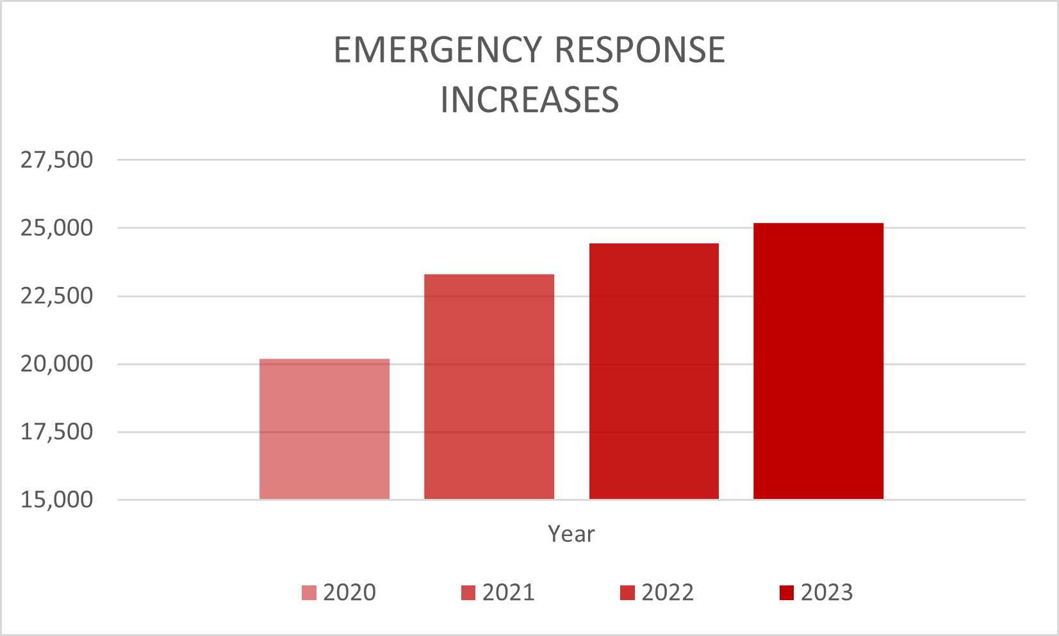

Year after year, emergency response needs from the community has risen significantly.
A Better Plan for the Future: The FBC
Matching Rising Demand with Stabilized Funding
Notes:
Year after year, emergency response needs from the community have risen significantly, both in the severity of call types and the increased number of EMS-related responses that place a higher demand on fire district resources.
Based on growth projections this will persist into the future.

Slide 10
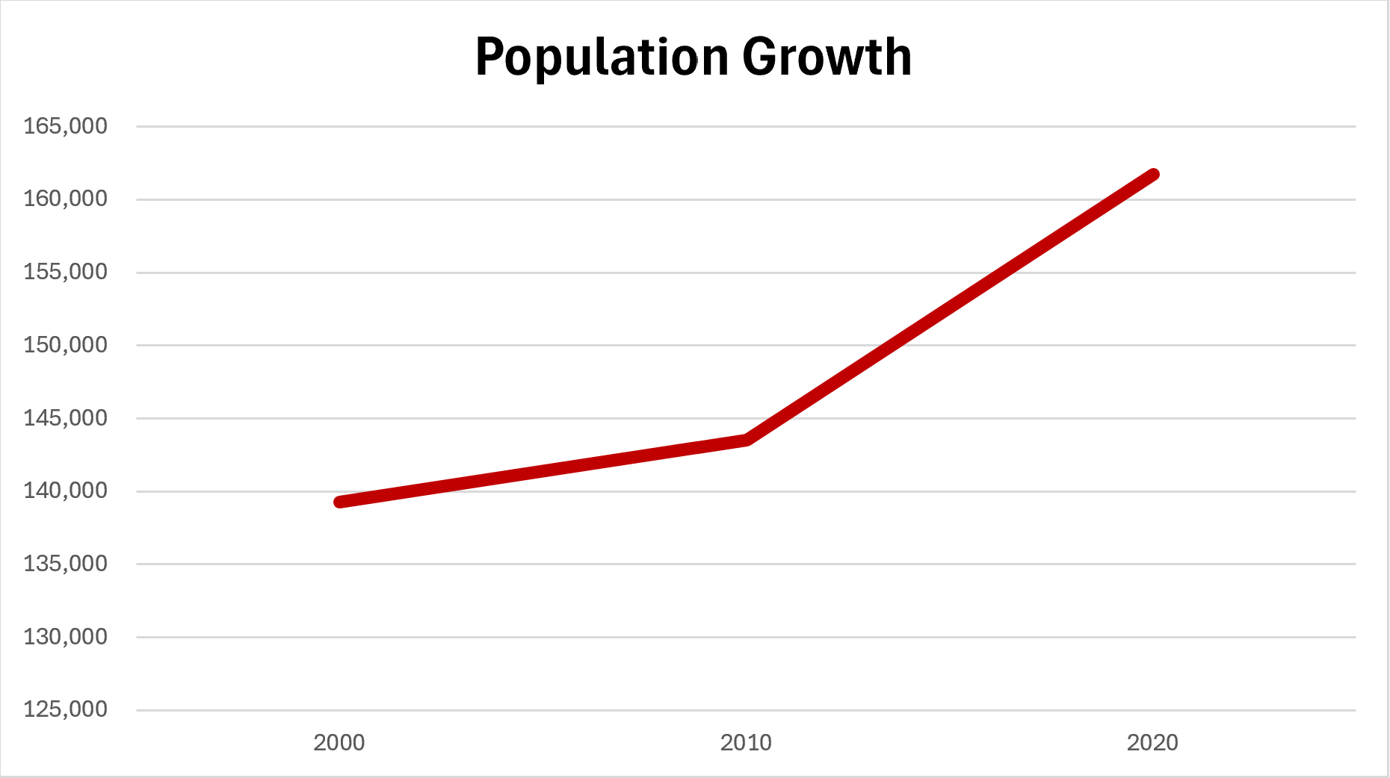
Growth projected to continue.
2000 | 2010 | 2020
139,287 | 143,495 | 161,750
US Census data
A Better Plan for the Future: The FBC
Matching Rising Demand with Stabilized Funding
Notes:
Here you can see the steep and steady increase in population growth that’s taken place over the past two decades, which is expected to rise.

Slide 11
This rising demand in emergency response calls is creating conditions that are: ​​
Unsustainable, surpassing what our current funding structure can support. ​
Negatively impacting response times and resource availability.
Due to population growth, higher density,
and community need,
additional resources are now required.
A Better Plan for the Future: The FBC
Matching Rising Demand with Stabilized Funding
Notes:
Every day, we continue to do our best to serve our communities. However, our resources are stretched thin.
The rising demand in emergency response calls is creating conditions that are unsustainable and negatively impacting response times and resource availability.
Due to the population growth, higher density, and evolving community needs, additional resources are now required.

Slide 12

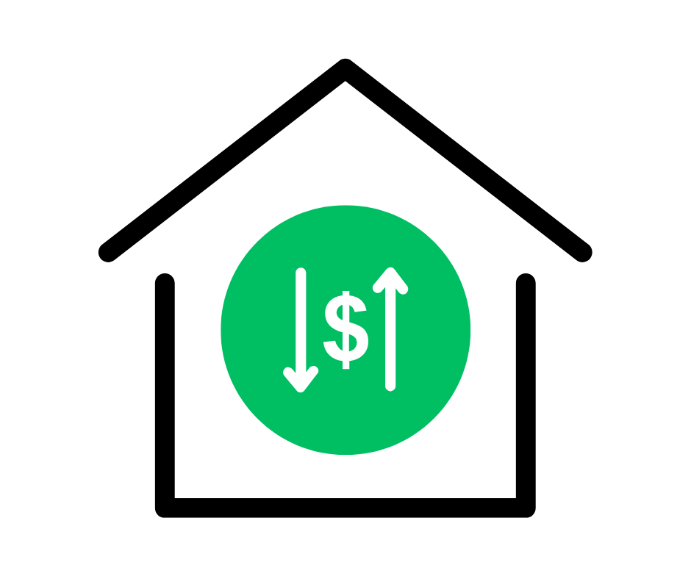

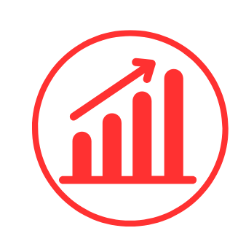
Current Funding Structure
RISING DEMAND
PROPERTY TAX FLUCTUATIONS
CYCLE OF UNCERTAINTY
A Better Plan for the Future: The FBC
Matching Increased Demand with Stabilized Funding
Notes:
Before we shift gears toward our proposition for a more stabilized approach, I’d like to touch on our current funding structure, which is inadequate to address this rising demand.
Every 2 -4 years the district has to run a costly ballot measure to ensure adequate funding, and it becomes difficult to plan for the future when funding is uncertain due to a heavy reliance on property taxes, which is subject to fluctuations.
The rising demand and property tax fluctuations create a “cycle of uncertainty”. Our current funding structure is outdated and unsustainable to meet the growing needs of our communities.

Slide 13
Current Funding Structure
$1.50 per $1,000 of AV – Regular Property Tax
$ .13 per $1,000 of AV – Maintenance & Operations Levy
$ .10 per $1,000 of AV – Safety Improvement Bond
$1.73 per $1,000 of AV = Total Fire Levy Rate
AV = Assessed Value
*Estimated 2024 levy rates based on 2024 budget
A Better Plan for the Future: The FBC
Matching Increased Demand with Stabilized Funding
Notes:
Here is our current funding structure, which as previously mentioned, is largely dependent on property taxes. It also includes the Maintenance & Operations Levy.

Slide 14
South King Fire is proposing a more stabilized funding approach with
the Fire Benefit Charge (FBC).
This will help better meet the current and future demands of our community by providing improved access to resources when responding to fire and emergency situations.
A Better Plan for the Future: The FBC
Matching Rising Demand with Stabilized Funding
Notes:
In order to uphold fiscal responsibility and effectively meet the rising demand, South King Fire is proposing a Fire Benefit Charge, also known as “FBC,” as a more stabilized approach to funding. This will help better meet the current and future demands of our community by providing improved access to resources when responding to fire and emergency situations.

Slide 15
The FBC is a more sustainable approach that distributes costs for the delivery of fire protection services.
Communities in other fire districts have supported the FBC, dating as far back as 2003:
Central Pierce Fire & Rescue
Graham Fire & Rescue
King County Fire District 40
Puget Sound Regional Fire Authority (Kent)
Renton Regional Fire Authority
Valley Regional Fire Authority (Auburn)
Woodinville Fire & Rescue
A Better Plan for the Future: The FBC
Matching Rising Demand with Stabilized Funding
Notes:
The FBC is a more sustainable approach that distributes costs for the delivery of fire protection services.
Communities in other fire districts have supported the FBC, dating back as far as 2003. You can see a list of those districts on the slide here.

Slide 16
What is a Fire Benefit Charge?
The FBC is not a tax.
It’s a fee based on structure size, property use, and fire risk factors.
It aims to place more cost on structures with higher fire risk and resource needs, and less cost to those with lower risk or resource needs.
Smaller structures (such as single-family homes) pay less than larger buildings (i.e. commercial buildings because it takes fewer resources to protect them in a fire. ​
A Better Plan for the Future: The FBC
Matching Rising Demand with Stabilized Funding
Notes:
The FBC is not a tax. It’s a fee based on structure size, property use, and fire risk factors.
It aims to place more cost on structures with higher fire risk and resource needs, and less cost to those with lower risk or resource needs.
For example: smaller structures (such as single-family homes) pay less than larger buildings (i.e., commercial buildings) because it takes fewer resources to protect them in a fire.

Slide 17
CURRENT
FUNDING
PROPOSED FUNDING WITH FBC
$1.50 per $1,000 of AV
(Regular Property Tax)
.13 cents per $1,000 of AV
(Maintenance & Operations Levy)
.10 cents per $1,000 of AV
(Safety Improvement Bond)
$1.00 per $1,000 of AV
(Regular Property Tax)
.10 cents per $1,000 of AV
(Safety Improvement Bond)
$1.73 per $1,000 of AV = Total Fire Levy Rate
$1.10 per $1,000 of AV = Total Fire Levy Rate
+
Voter-approved *FBC
A Better Plan for the Future: The FBC
Matching Rising Demand with Stabilized Funding
*FBC is based on property size and risk.
Residential parcels on average are defined as lower risk and generally pay less.
Notes:
On the left, you see our current funding model. On the right, is the proposed funding with the FBC.
If voters approve the FBC, it will lower regular property tax levy by eliminating the need for a renewed Maintenance & Operations levy, and it will ensure consistent funding by relying less on property tax, which as mentioned, can be subject to fluctuations.
Property taxes would be reduced from $1.50 to $1.00 per assessed value.
FBC is based on property size and risk.
Residential parcels on average are defined as lower risk and generally pay less.

Slide 18
HOW IS THE FIRE BENEFIT CHARGE CALCULATED?
The FBC is calculated using a formula that considers key factors such as the square footage of structures (i.e. buildings), and for commercial properties, any specific hazards.
Four property types:
  mobile homes
  single family
  commercial
  multi-family
A Better Plan for the Future: The FBC
Matching Rising Demand with Stabilized Funding
Notes:
The FBC is calculated using a formula that considers key factors such as the square footage of structures (i.e., buildings), and for commercial properties, any additional specific hazards.
There are four property types, including mobile homes, single family, commercial, and multi-family.

Slide 19

PROPOSED FUNDING WITH FBC
1,750 SQFT House +
440 SQFT Garage
2,240 SQFT House
+ 780 SQFT Garage
2,740 SQFT House + 280 SQFT Basement + 960 SQFT Garage
BEFORE
Property Tax: $874.82
AFTER
Property Tax: $549.36
FBC: $283.50
Total: $832.86
BEFORE
Property Tax: $1,081.38
AFTER
Property Tax: $679.07
FBC: $342.99
Total: $1,022.06
BEFORE
Property Tax: $1,530.93
AFTER
Property Tax: $961.38
FBC: $452.08
Total: $1,413.46
Reduction: $41.96
Reduction: $59.32
Reduction: $117.47
**These property tax estimates are based off of 2024 collections according to King County's assessed values.
FBC rates are estimated using King County's Assessed Value (AV) projections for 2025.
A Better Plan for the Future: The FBC
Matching Rising Demand with Stabilized Funding
Notes:
As mentioned previously, the FBC is a fee is based on a formula that calculates property size, use, risk, and other hazards. Smaller structures (such as single-family homes) generally pay less than larger buildings (i.e. commercial buildings) because it takes fewer resources to protect them in a fire.
Here are three examples. The "BEFORE" is how much the homeowner would pay under the current funding model. The "AFTER" is what the homeowner would pay if the FBC is approved.
**These property tax estimates are based off of 2024 collections according to King County's assessed values.
FBC rates are estimated using King County's Assessed Value (AV) projections for 2025.

Slide 20
Exemptions
​The Fire Benefit Charge is not a tax, so property tax-exempt entities, e.g., governments and charitable organizations, are not necessarily exempt from the FBC. However, certain exemptions and limits do apply, including: ​
​Certain non-profit organization-owned properties based on their property tax exemption under the RCW. ​
Public Schools – Public schools who pay a per student stipend are exempt from the benefit charge. ​
Religious organizations are exempt for buildings used for religious services and other purposes related to bona fide religious ministries (i.e. churches, synagogues, and other places of worship). ​
Schools owned by religious organizations are exempt for K-12 and higher education, but not for buildings used primarily for preschool and daycare. ​
*Refer to RCW 52.18.010 for the full list of exemptions.
Discounts
Low-income seniors or disabled persons that qualify for property tax discounts will receive the same percentage discount on the FBC. These discounts are administered through the King County Assessor’s Office. Only King County can grant the discounts.
A Better Plan for the Future: The FBC
Matching Rising Demand with Stabilized Funding
Notes:
Exemptions
The Fire Benefit Charge is not a tax, so property tax-exempt entities, e.g., governments and charitable organizations, are not necessarily exempt from the FBC. However, certain exemptions and limits do apply, which include but are not limited to:
Certain non-profit organization-owned properties based on their property tax exemption under RCW.
Public Schools – Public schools who pay a per student stipend are exempt from the benefit charge.
Religious organizations are exempt for buildings used for religious services and other purposes related to bona fide religious ministries (Churches, synagogues, and other places of worship).
Schools owned by religious organizations are exempt for K-12 and higher education, but not for buildings used primarily for preschool and daycare.
For a full list of exemptions, review RCW 52.18.010.
Discounts
Low-income seniors or disabled persons that qualify for property tax discounts will receive the same percentage discount on the FBC. These discounts are administered through the King County Assessor’s Office. Only King County can grant the discounts.
For more information on qualifications, please visit King County’s website. The link can be found in SKR's FAQs.

Slide 21
Fire Benefit Charge – August 6, 2024 Ballot
South King Fire will be placing the FBC on the August 6, 2024 ballot. To initially implement the FBC, it requires a 60% majority vote.
If voters approve, the FBC would be in place for six years (2025-2030).
After the initial approval (six-year term), voters would decide whether to reauthorize the FBC. Extending it for an additional six or ten years requires a simple majority vote, whereas a permanent extension requires 60% voter approval.
A Better Plan for the Future: The FBC
Matching Rising Demand with Stabilized Funding
Notes:
South King Fire will be placing the FBC on the August 6, 2024, ballot. To initially implement the FBC, it requires a 60% majority vote.
If voters approve, the FBC would be in place for a six-year term.
After the initial approval (six-year term), voters would decide whether to reauthorize the FBC for an additional six or ten years would require a simple majority vote. A permanent extension requires 60% voter approval.

Slide 22



What If the Fire Benefit Charge is Not Approved by Voters
The primary funding source from property tax levies would remain at or up to $1.50 per $1,000 of assessed value.
South King Fire would experience an immediate annual budget shortfall of $3.75M per year due to the expiration of the current M&O levy at the end of 2024. The loss of revenue would require significant budget cuts, impacting levels of service and response times.
South King Fire would need to place another multi-year Maintenance & Operations levy on the ballot in 2025 to balance the budget and maintain service levels.
A Better Plan for the Future: The FBC
Matching Rising Demand with Stabilized Funding
Notes:
If the Fire Benefit Charge is not approved by voters, the primary funding source from property tax levies would remain at or up to $1.50 per $1,000 of assessed value.
South King Fire would experience an immediate annual budget shortfall of $3.75M per year due to the expiration of the current M&O levy at the end of 2024. The loss of revenue would require significant budget cuts, impacting levels of service and response times.
South King Fire would also need to place another multi-year Maintenance & Operations levy on the ballot in 2025 to balance the budget and maintain service levels.

Slide 23
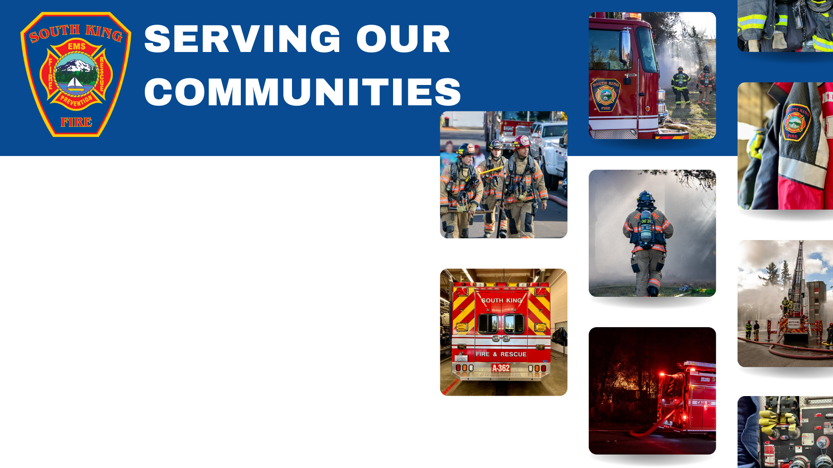

Notes:
At South King Fire, we are proud to celebrate 75 years of serving our communities. Our firefighters respond 24/7 to serve and protect residents in need. We are committed to continuing being good stewards to our communities for the next 75 years and beyond.

Slide 24

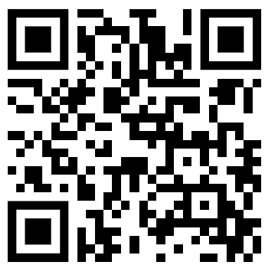
For more information:
www.southkingfire.org/fbc
fbc@southkingfire.org
253-839-6234
A Better Plan for the Future: The FBC
Matching Rising Demand with Stabilized Funding
Notes:
For more information, please don’t hesitate to contact us. We’re happy to answer any questions you might have. You can reach us at our website www.southkingfire.org/fbc, through email fbc@southkingfire.org, or by phone 253-296-6515.

Slide 25
Public Disclosure Commission Guidelines
Permitted on Work Time | Permitted on Your Own Time | Not Permitted
Respond to questions about the ballot proposition by providing the facts. Display campaign materials on your personal vehicle. Hold informational meetings and present facts about the levy or bond. Encourage people to register to vote and to vote on Election Day. Wear campaign buttons, T- shirts, etc. | Campaign for or against the ballot proposition. Display campaign materials on your personal vehicles. Organize and participate in rallies and sign waving events. Make phone calls or doorbell. Fundraise or make personal contributions. Wear campaign buttons, T-shirts, etc. | Use district supplies, equipment, or facilities to print, email, distribute or otherwise produce materials to promote or oppose the ballot proposition. Display promotional campaign materials in or on district vehicles or in district publications. Post promotional campaign materials in fire district facilities or on fire district grounds.
STAFF ONLY SLIDE
Notes:
Slide for Presenting to Staff☺
The Public Disclosure Commission (PDC) which governs the activities of public employees such as the fire district during elections, defines two types of activities: informational activities provide facts, while promotional activities support a specific view, such as in a Vote Yes campaign.
The general rule of thumb is that fire district resources-including staff work time, copy machines, computers, e-mail services, and facilities-can be used only for informational purposes. Any promotional activity must be done on your own time and may not use South King Fire resources.
Refer to the PDC guideline document to know what is permitted on work time, what is permitted on personal time, and what is not permitted.

Slide 26

Questions?
A Better Plan for the Future: The FBC
Matching Rising Demand with Stabilized Funding
Notes:
Thank you for your time today.
I have time [include how much, 5 minutes, etc.] to answer some questions. {If you don’t have an immediate answer to their question, offer ways to follow up.]
[TIME FOR QUESTIONS]
Thanks so much for your time today. I hope you have a wonderful day, and please remember to vote on August 6. We appreciate your continued support.

