Slide 1
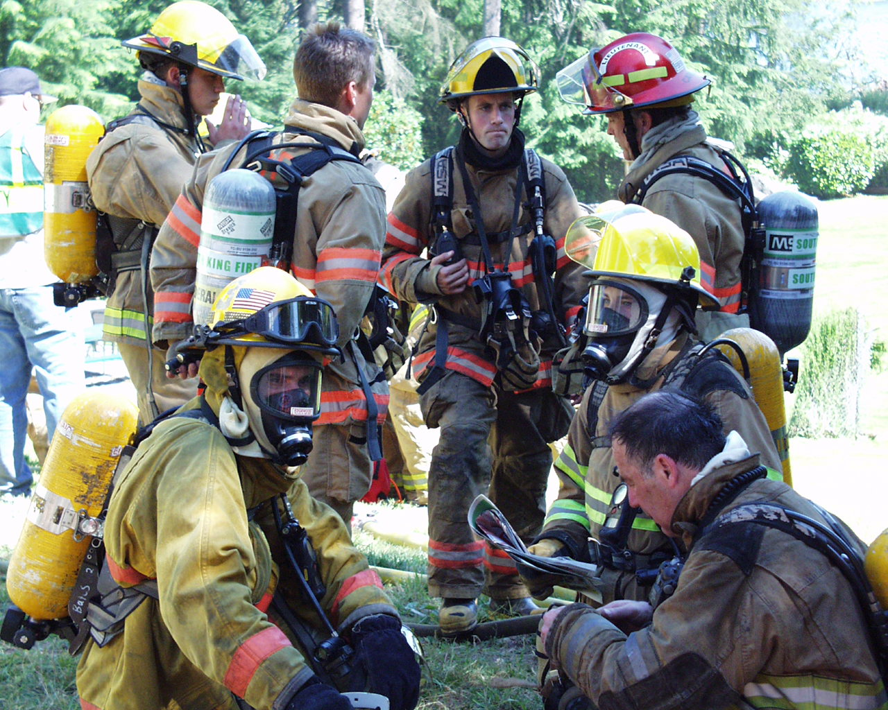

BOND PLANNING
FIRE STATION, EMERGENCY RESPONSE,
AND
COMMUNITY SAFETY IMPROVEMENTS

Slide 2
BOND PLANNING
FIRST PRIORITY
Get firefighters safely to emergencies to help those in need.
To make that happen we need…
  People - Firefighter EMTs
  Apparatus
  Facilities
  Equipment

Slide 3
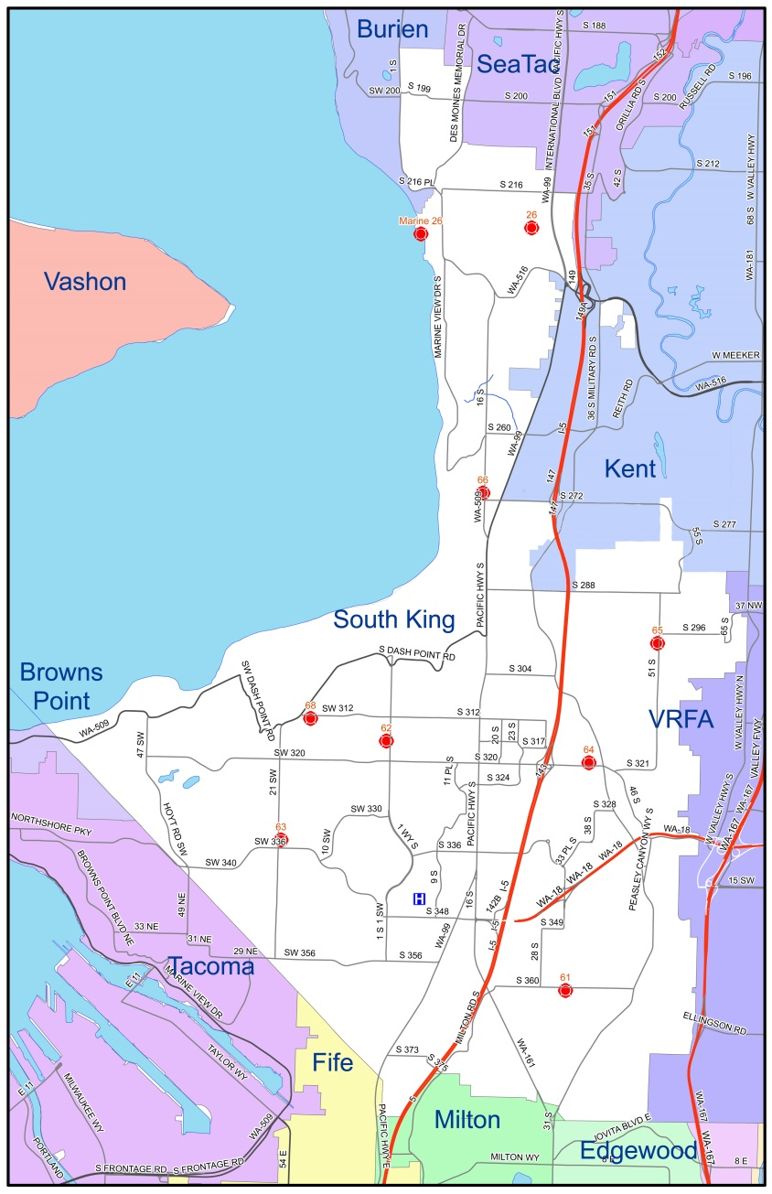
BOND PLANNING
DISTRICT FACTS
Station 67
Square Miles: 41
Population: 150,000
Responses: 17,695
Budget: 25M
  $1.50/1000 AV
  $0.29 M&O Levy
Station 66
Station 65
Station 64
Station 68
Station 62
Station 61
Station 63

Slide 4
BOND PLANNING
LOOKING BACK
History and Governance of Fire District #39
Fire District Funding
Capital Replacement History

Slide 5
BOND PLANNING
CAPITAL NEEDS
Capital Needs Now and Future

Slide 6
BOND PLANNING
PROPOSITION #1
FIRE STATION, EMERGENCY RESPONSE,
AND
COMMUNITY SAFETY IMPROVEMENTS

Slide 7
BOND PLANNING
BOND COST
FIRE STATION, EMERGENCY RESPONSE,
AND
COMMUNITY SAFETY IMPROVEMENTS
$39M, 20 yr. Gen. Obligation Bond
Rate = $.16 per $1,000
If Home Value = $250,000
  Cost = $40 /year
  Cost = $3.33/month

Slide 8
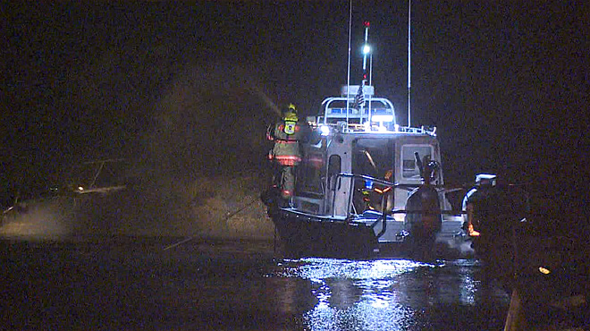
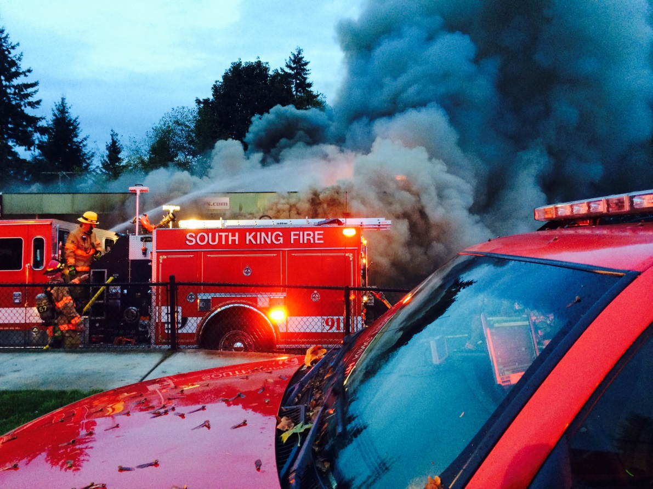
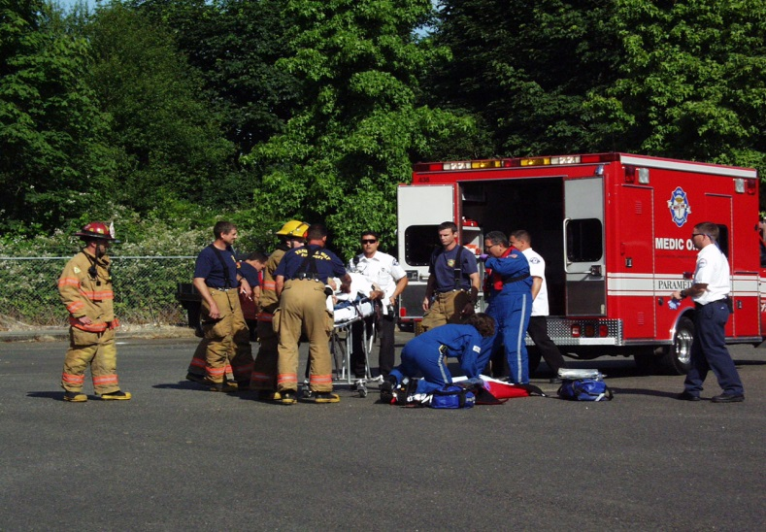
BOND PLANNING
BOND PLANNING
WE ARE BUSY!

Slide 9
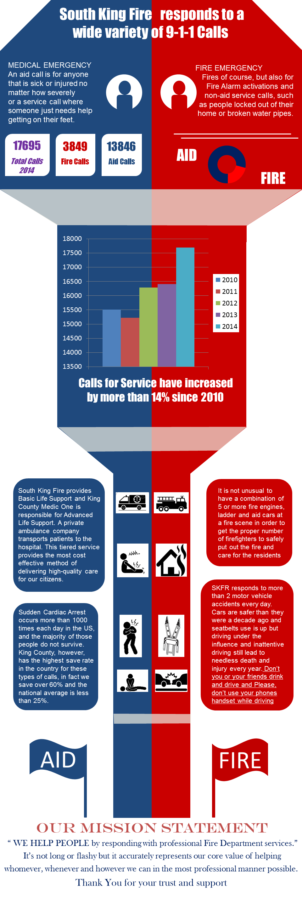
BOND PLANNING
EMERGENCY
RESPONSE INCREASES

Slide 10
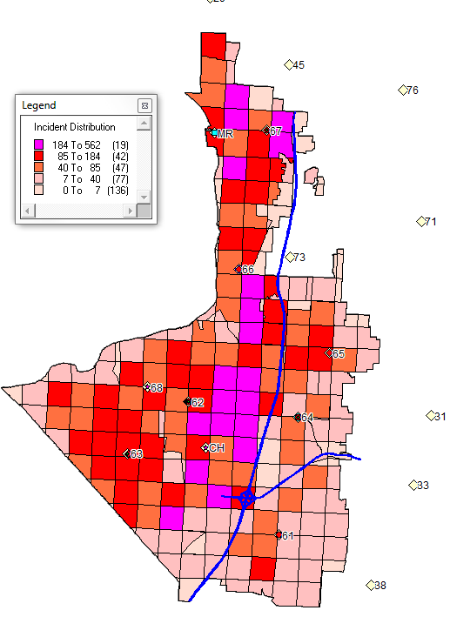
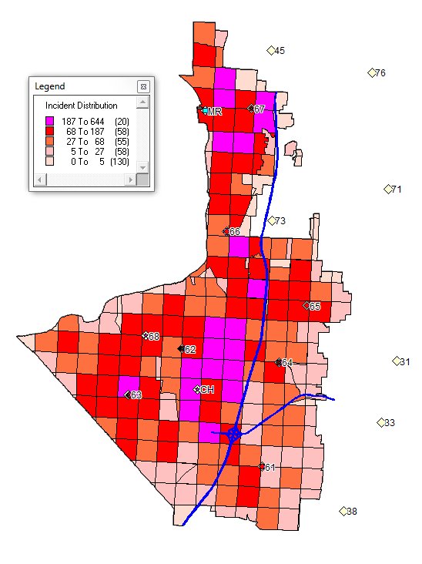
BOND PLANNING
RESPONSE CONCENTRATION
2013 Responses
16,408
2014
17,695
2020
?
2009 Responses

Slide 11
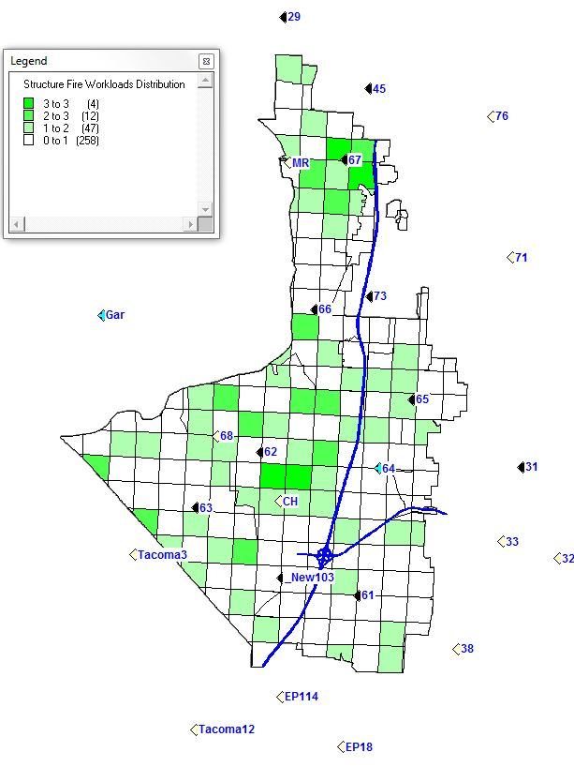
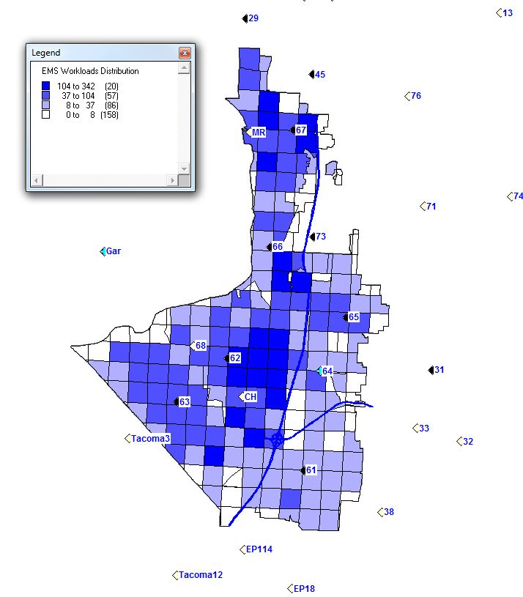
BOND PLANNING
EMS RESPONSE CONCENTRATION

Slide 12
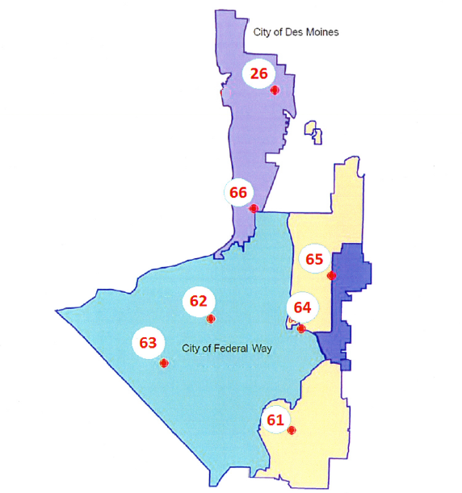
BOND PLANNING
PROPOSED DEVELOPMENT
Des Moines Creek Business Park:
3-buildings, 536K SF
Artemis: 7-story, 222 rooms
67
Sea Mar: 3-story, 43 units
Federal Way Veteran’s Center, 1 bldg., 7 story, 45 units
New Federal Way High School:
3 stories, 233K SF
FW Town Homes:
6-buildings, 3-story,
26 units
High Point Apt over Retail: 6 story,15 buildings,308 units
Kitts Corner Apts:
16-buildings, 3-story,
218 units
Celebration Senior Living:
2-buildings, 6-story, 380 units
Progressive Insurance
17,000 SF
Christian Faith Center:
1-building, 2-story, 37K SF
Park 16 Apts: 26-buildings,
3-story, 300 units

Slide 13
BOND PLANNING
PROPOSED OCCUPANCIES
Residential/Commercial mixed use, 1 bldg., 7 story, 118,000 sq. feet
Redevelop existing senior complex, several bldgs., 3 -5 story, 221 new units
67
Residential & Retail 10 bldgs., 4&5 story, 372 units
Senior apartments 1 bldg., 5 story, 135 units
Senior Living, 1 bldg., 6 story, 197 units
Residential & Retail 1 bldg., 4 story, 82 units
Recovery & Treatment Complex 5 buildings 95,000 SF
Performing Arts & Conference Center, 1 bldg. 1 story, 44,000 sq. feet
Assisted Senior Living:
two 3-story buildings, 18 duplexes, 98 units
Residential & Retail 1 new building, 7 story, remodel existing. 92 units

Slide 14
BOND PLANNING
HELPING PEOPLE
 | Planned Multi Family Units | Proposed Multi Family Units | Planned Large Bldgs. | Proposed Large Bldgs.
Federal Way | 1277 | 387 | 287,000 | 44,000
Des Moines | 265 | 885 | 536,000 | 213,000
 | 1542 | 1272 | 823,000 | 257,000
Total Units | 2,814 | Total Sq. Feet | 1,080,000

Slide 15
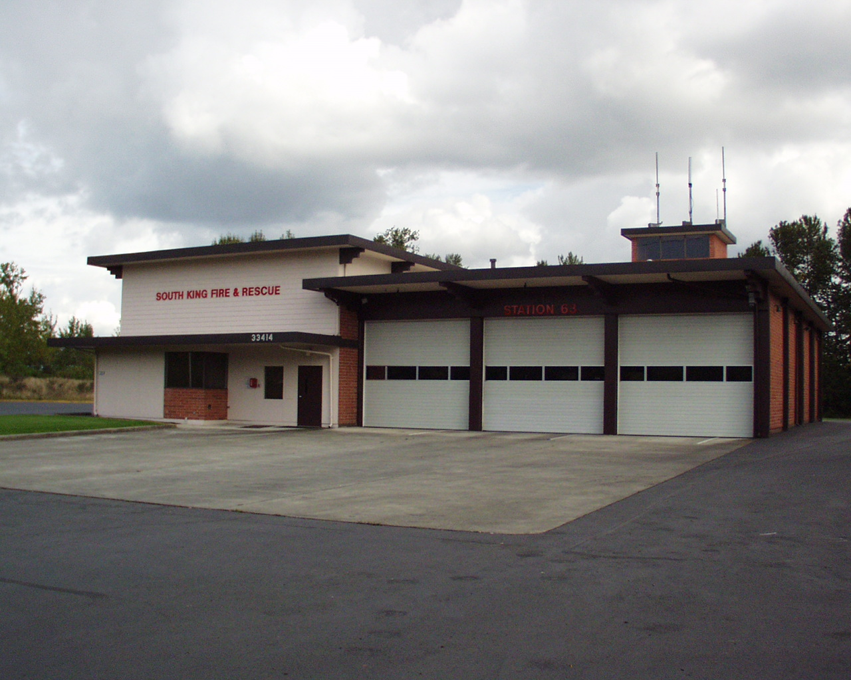
BOND PLANNING
FACILITIES

Slide 16
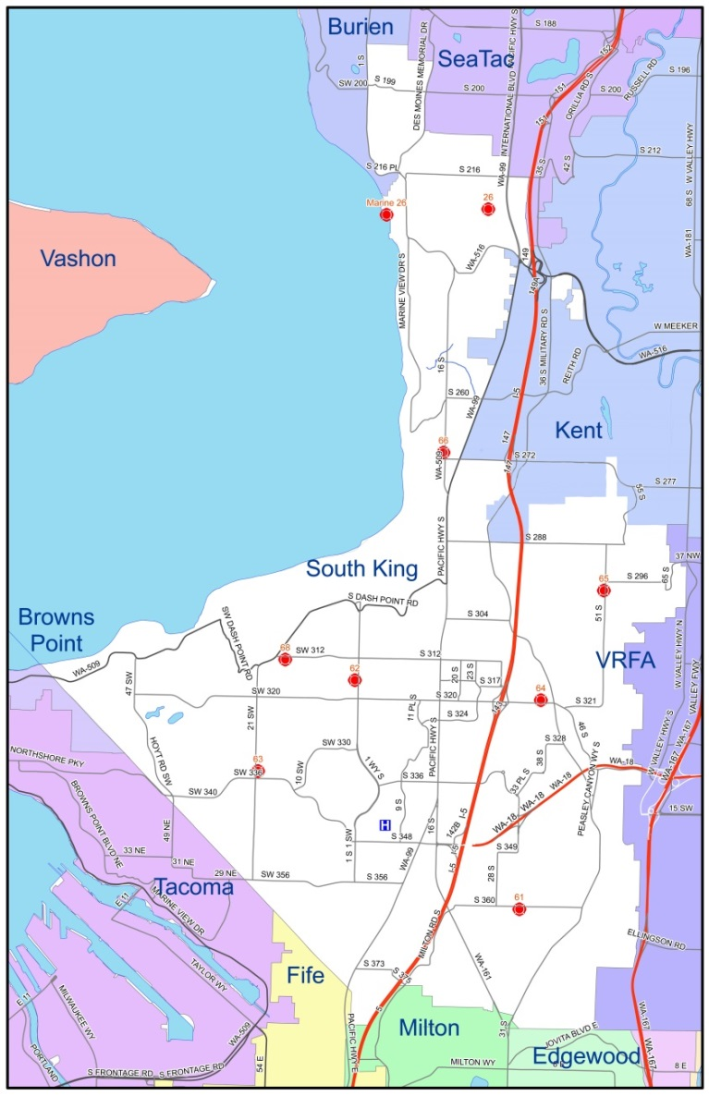
BOND PLANNING
STATION LOCATIONS & AGES
Station 67
Built: 1970 (45 yr.)
Remodel: 1999
Station 62
Built: 1978 (37 yr.)
Remodel: 1985
Station 66
Built: 1966 (49 yr.)
Remodel: 1984
Station 68
Built: 1964 (51 yr.)
Remodel: 1986
Station 65
Built: 1968 (47 yr.)
Remodel: 1985
Fleet/Facilities
Built: Proposed
Station 64
Built: 1987 (28 yr.)
Remodel:
Station 63
Built: 1964 (51 yr.)
Remodel: 1984/10
Station 61
Built: 1979 (36 yr.)
Remodel:
Station 60
Built: Proposed

Slide 17
BOND PLANNING
FIRE STATION & FACILITY IMPROVEMENTS = $31.6M
Safety Improvements for all Stations:
Earthquake Retrofitting & Safety Improvements at All Stations
Ventilation Upgrades and Decontamination Areas at All Stations
Replacement of Aged & Deteriorated Roofs at 4 Stations
Emergency Back-Up Generators at All Stations, 24/7 Readiness
Firefighter Training Site Expansion
Property & Existing Debt Consolidation
* Note: Fire Stations are 30-50 years old.

Slide 18
BOND PLANNING
FIRE STATION & FACILITY IMPROVEMENTS = $31.6M
Safety Improvements for all Stations cont’d:
Site Security: Provide fences and gates at all stations.
Access Control: Provide security and access control systems at each station.
Maintenance and operational improvements for mechanical and electrical systems.
Fueling station upgrades and improvements at each station.

Slide 19
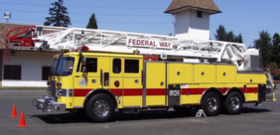
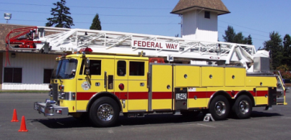



BOND PLANNING
APPARATUS LIFE CYCLE
Design & Purchase
1 Year
Surplus
Outfit in Shop
3 Months
Reserve Status
Train Crews
10- Years
1 Month
Primary Service
10 Years

Slide 20
BOND PLANNING
FIRE ENGINE REPLACEMENTS
NFPA 1901 Recommendation is 20 years
Engine | Annual Miles | Current Mileage | Surplus?-Miles
1994 Pierce Tele-Squirt 641 | 2,332 | 143,987 | 2018 w/aerial-151,715
1995 Pierce 631 | 3,465 | 144,258 | 2016-148,679
1995 Pierce 651 | 3,821 | 137,850 | 2016-150,184
1995 Pierce 671 | 1,464 | 120,175 | 2018-126,031
2002 KME E63 | 10,011 | 126,176 | 2020-149,747
2002 KME E66 | 7,410 | 106,304 | 2020-142,943
2002 KME E65 | 6,349 | 92,912 | 2020 142,943
Mileage Reading from March 2015

Slide 21
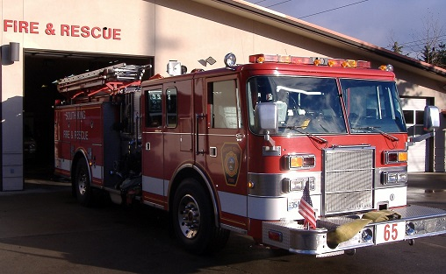
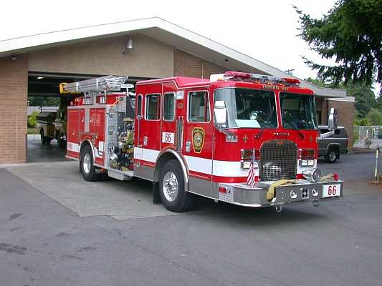
BOND PLANNING
ENGINE RESERVE FLEET
 | 2014 |  |  | 2016
Engine | Status | Miles |  | Status | Miles | Age
1995 Pierce | Reserve | 143 K |  | Surplus | 148 K | 21 Years
 | 2014 |  |  | 2016 |  |  | 2020
Engine | Status | Miles |  | Status | Miles |  | Status | Miles | Age
2002 KME | Primary (13 years) | 126 K |  | Reserve | 141 K |  | Surplus | 171 K | 18 Years
 |  |  |  | 2016 |  |  | 2026 |  |  | 2036
 |  |  |  | Status | Miles |  | Status | Miles |  | Status | Miles | Age
 |  |  |  | Primary | 0 |  | Reserve | 100,000 |  | Surplus | 150,000 | 20 Years
Mileage Reading from March 2015

Slide 22
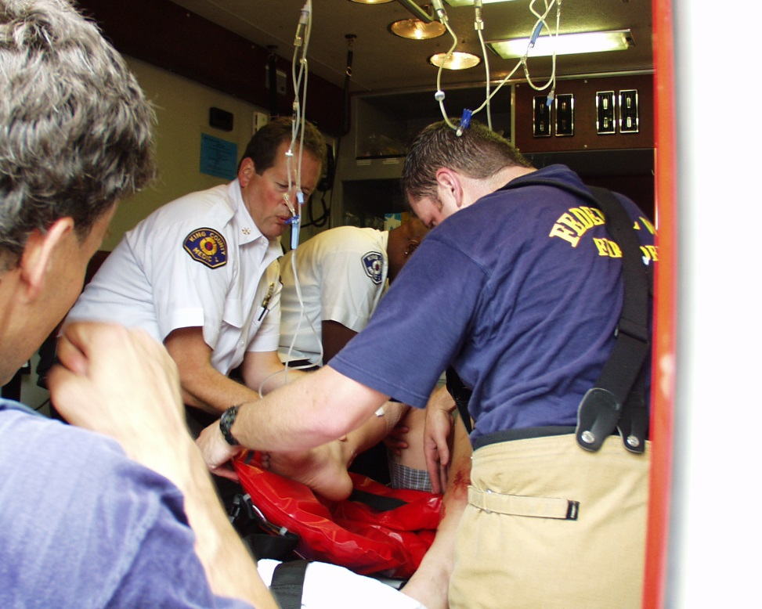
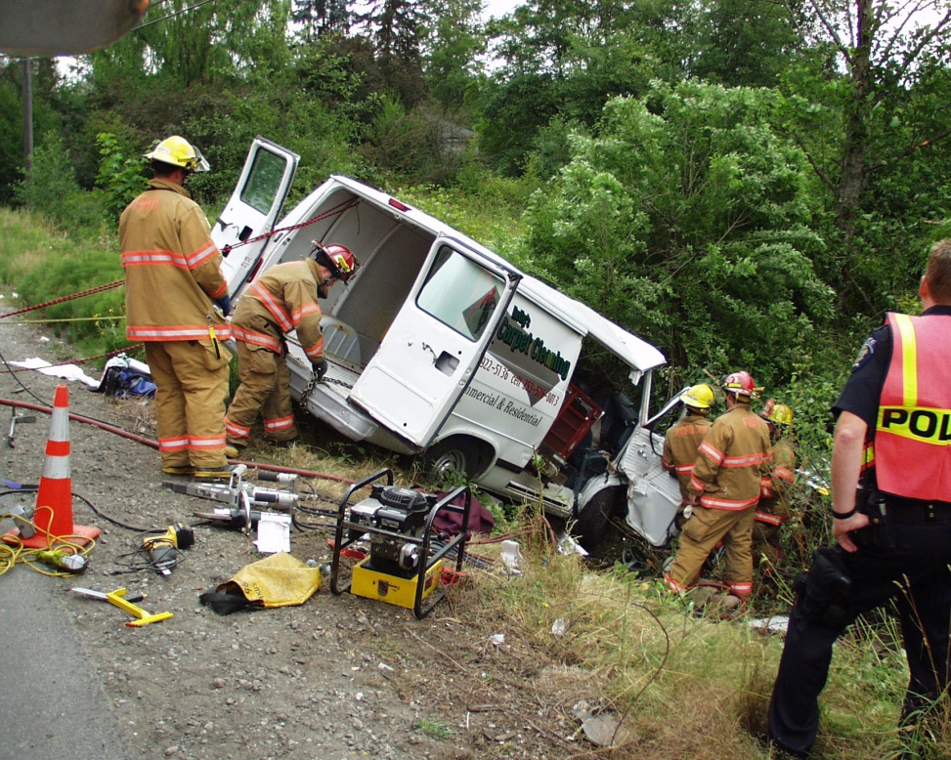
BOND PLANNING
AID CAR REPLACEMENTS
75%-80% of our Responses Are Medical Aid
Aid Cars Improve Response Time

Slide 23
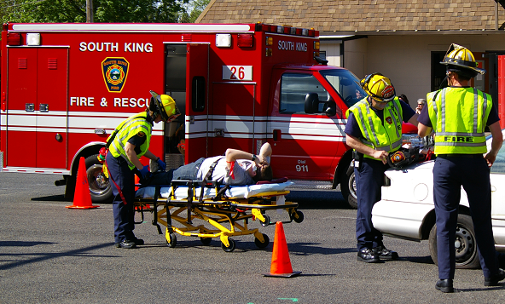
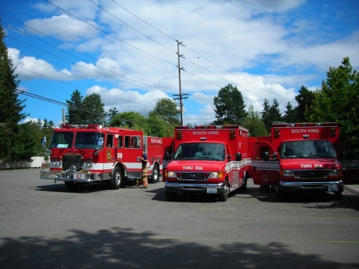
BOND PLANNING
AID CAR RESERVE FLEET
 | 2014 |  |  | 2016
Aid Car | Status | Miles |  | Status | Miles | Age
2000 Braun | Reserve | 62,507 |  | Surplus | 64,100 K | 16 Years
 | 2014 |  |  | 2016 |  |  | 2020
Aid Car | Status | Miles |  | Status | Miles |  | Status | Miles | Age
2003 Braun | Primary (13 years) | 105,195 K |  | Reserve | 116 K |  | Surplus | 124 K | 17 Years
 |  |  |  | 2016 |  |  | 2022 |  |  | 2026
 |  |  |  | Status | Miles |  | Status | Miles |  | Status | Miles | Age
 |  |  |  | Primary | 0 |  | Reserve | 80,000 |  | Surplus | 100,000 | 10 yr.
Mileage Reading from March 2015

Slide 24
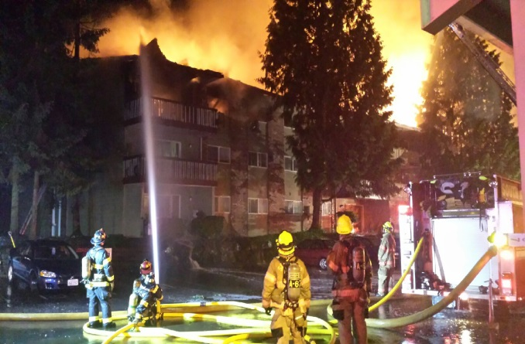
BOND PLANNING
EMERGENCY VEHICLE REPLACEMENTS = $6.2M
Listed Vehicle Replacements:
5 Fire Engines
1 Ladder Truck
5 Emergency Medical Aid Cars
4 Fire Investigator Trucks
10 Incident Response Training & Support Staff Vehicles
*Note: Existing Response Vehicles are 15-23 years old.

Slide 25
BOND PLANNING
TECHNOLOGY IN FIRE SERVICE
How we use technology during and for emergency response:
Portable and Mobile Radios
Mobile Data Computers (Computer Aided Dispatch)
Alerting and Notification Systems
Internet and Cellular Connectivity
GPS & Mapping
Cardiac Defibrillator (AED)
Thermal Imagers
Radios
Mobile Data Computers
Defibrillator
Connectivity

Slide 26
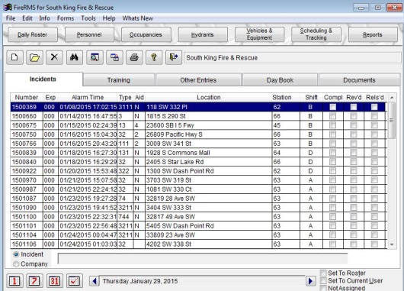
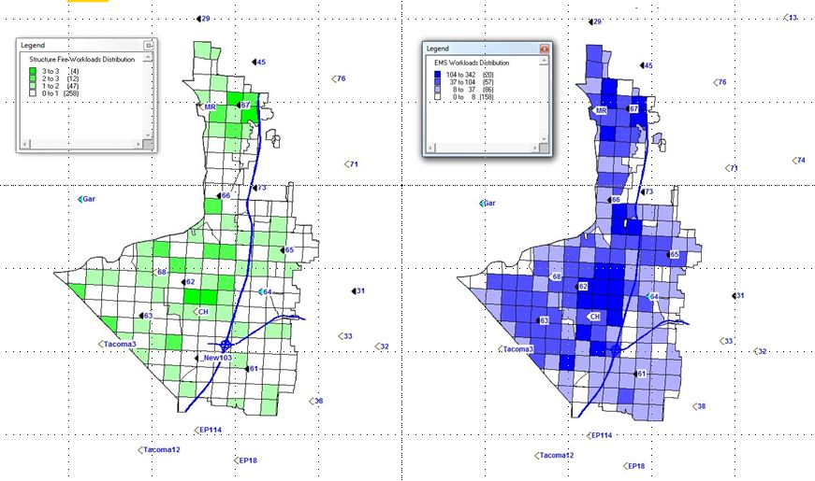

BOND PLANNING
TECHNOLOGY IN FIRE SERVICE
How we use technology before and after response:
CAD - Records Management System (RMS)
Data Review, Reporting, and Export to County & State
DECCAN – Data Analysis for Strategic Growth & Deployment Planning
Computer based Training & Simulation
Quality Assurance

Slide 27
BOND PLANNING
MODERNIZE TECHNOLOGY = $1.2M
Update Secure Communications & Computer-Aided Dispatch Equipment
Update GPS Mapping for Rapid Response & Routing
Coordinated Communication Systems With Local Agencies
Real-Time Date Sharing With Area Hospitals to Improve Emergency Care
Improved Cardiac Response Equipment on Response Apparatus

Slide 28
BOND PLANNING
COMMUNITY DISCUSSION
FIRE STATION, EMERGENCY RESPONSE,
AND
COMMUNITY SAFETY IMPROVEMENTS

